Slide 1


Building Contextual Chatbot using LLMs, Vector Databases and Python
Nabanita Roy
Senior Data Scientist/Manager @ EY Ireland
Education Lead @ Women in AI Ireland

Slide 2
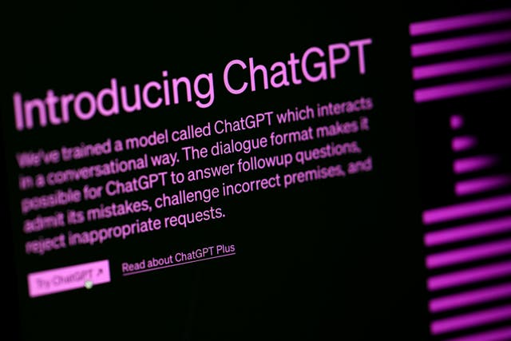
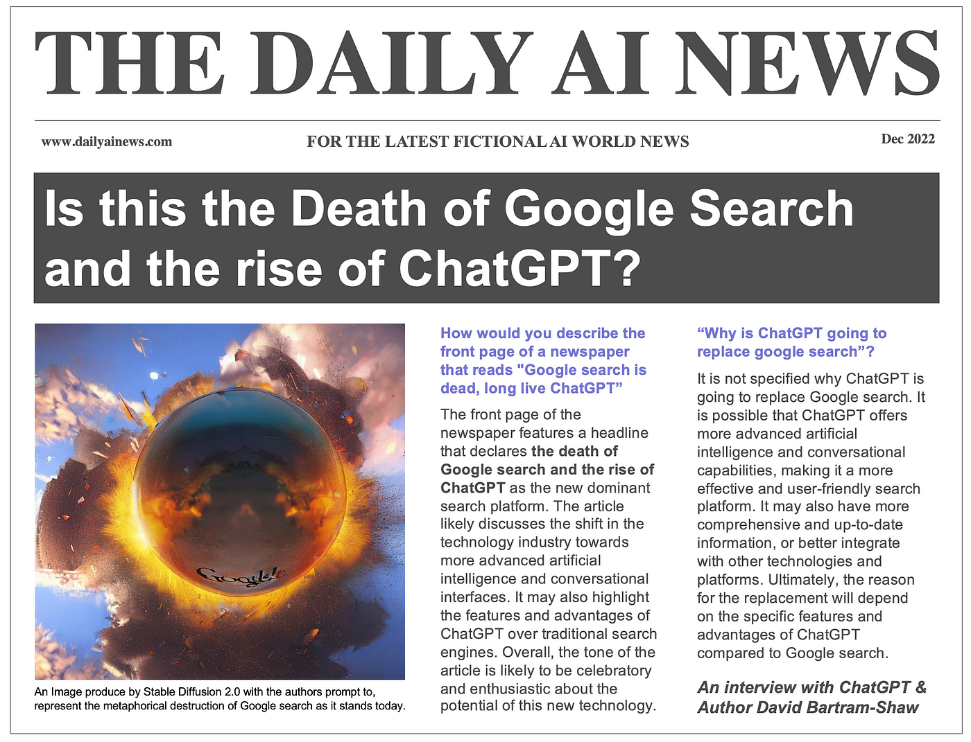
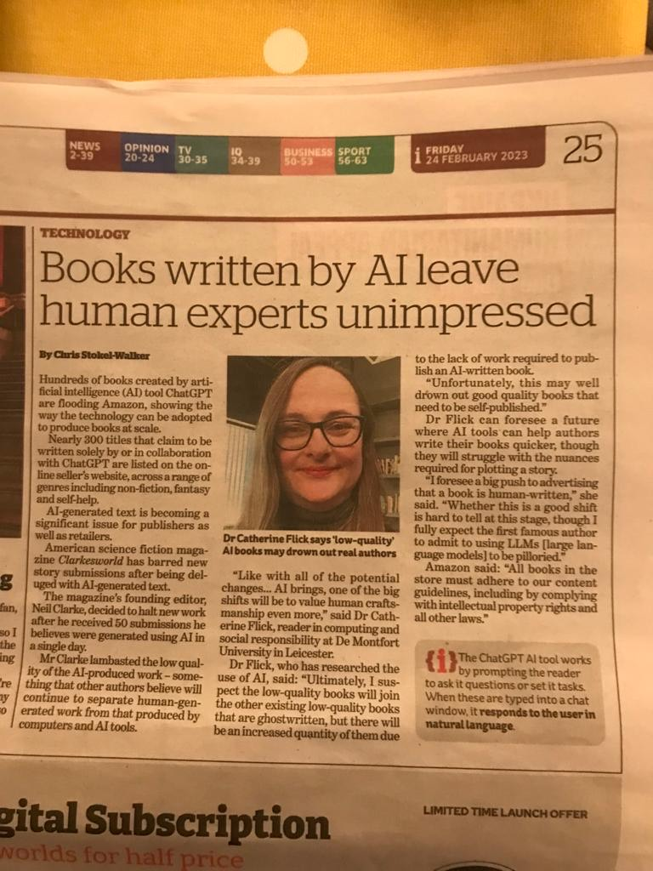
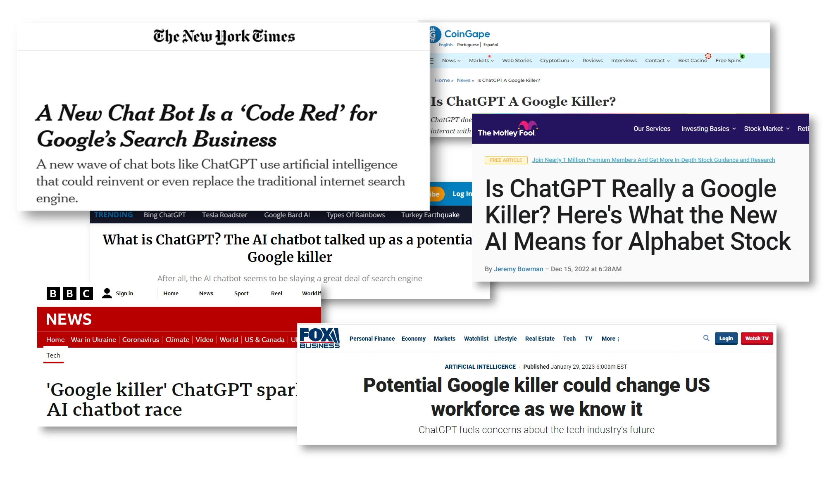
WORLD AFTER
30th NOVEMBER 2022

Slide 3
What is
GENERATIVE AI?
AI
A Large Language Model is a trained Deep Learning model that has the ability to understand and generate natural language.
Can accomplish a multitude of text-based tasks like classification, extraction, summarization, QA, etc
ML
DL
LLM
GEN AI
Generative AI is a type of AI that can create new content (a probable response) based on what it has learnt.
BTS: A Large Transformer

Slide 4
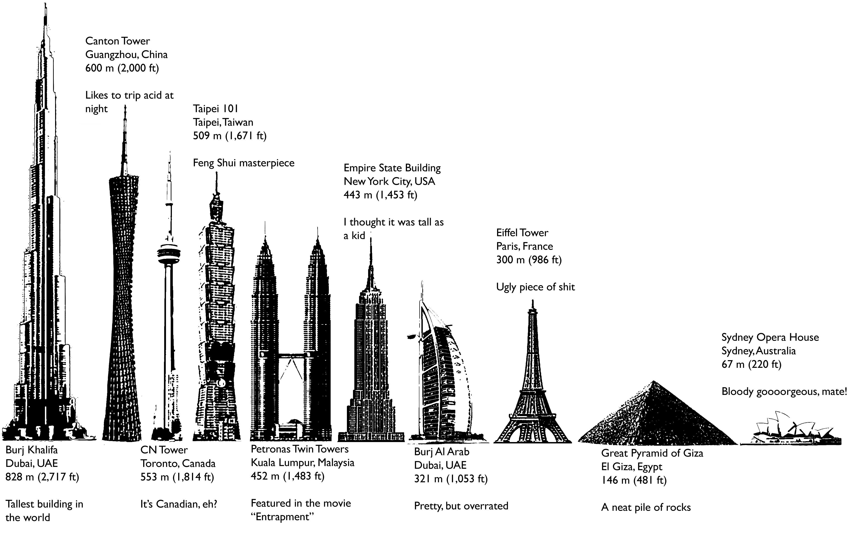
LARGE LANGUAGE MODELS
How
large
is
large?

Slide 5
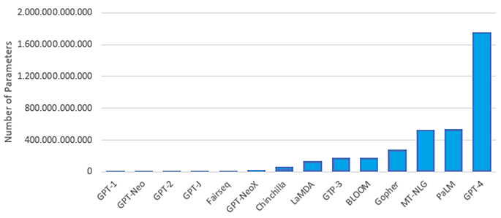
LARGE LANGUAGE MODELS
How
large
is
large?
Notes:
According to some sources, it is true that GPT-4 has 1.7 trillion parameters. This makes it 1000 times larger than GPT-2 and nearly 1000 times larger than GPT-3

Slide 6
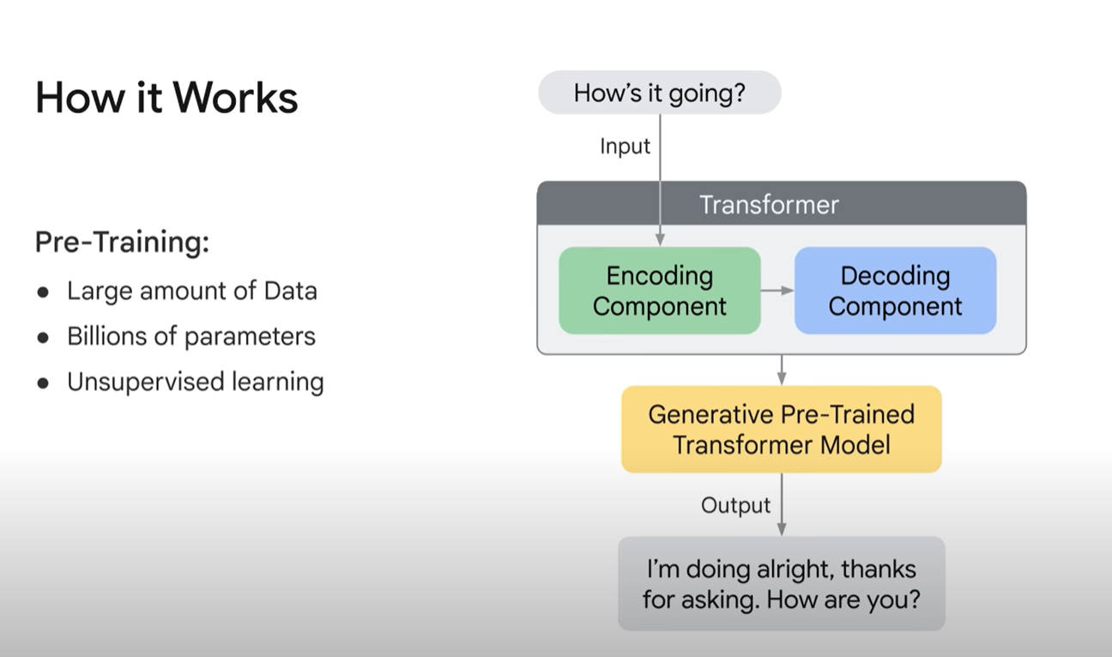
BTS: LARGE LANGUAGE MODELS
Image Source: https://www.youtube.com/watch?v=G2fqAlgmoPo

Slide 7
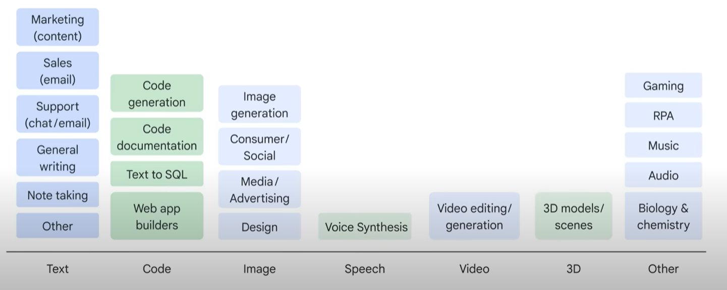
APPLICATIONS of LLMS
Image Source: https://www.youtube.com/watch?v=G2fqAlgmoPo

Slide 8



THE OPENAI WAVE
Generate a job description for Data Scientist role.
How to cure my back pain?
Summarize the following…
Who won the Football World Cup in 2000?
Write a code in Python to generate Fibonacci series.
What is … / When was… / How to… / Where is / …
Ability to interact with an AI Agent in natural language!
Uncanny ability to answer to all questions!!
Terrific problem-solving skills!!!

Slide 9

THE OPENAI WAVE
Generate a job description for Data Scientist role for XYZ company. We are a large XYZ retail company, and we are looking for a candidate for our customer analytics domain.
Core Skills: Python, NLP
Years of experience: 2+
Format: Job Summary, Key Responsibilities, Benefits
Prompt Engineering
More context
Clear Specifications
Output format/structure

Slide 10
THE OPENAI WAVE
Generate a job description for Data Scientist role for XYZ company. We are a large XYZ retail company, and we are looking for a candidate for our customer analytics domain.
Core Skills: Python, NLP
Years of experience: 2+
Format: Job Summary, Key Responsibilities, Benefits
Response in bullet Points
Prompt Engineering
More context
Clear Specifications
Output format/structure
Iteration

Slide 11

THE OPENAI WAVE
BASIC PROMPTING DEMO
https://platform.openai.com/docs/quickstart?context=python
https://github.com/royn5618/Talks_Resources/blob/main/PyDataGlobal2023/OpenAI_Basic_Prompting.ipynb
Link to Jupyter Notebook

Slide 12



THE OPENAI WAVE
ROLES IN OPENAI
CHAT COMPLETION MODULE
SYSTEM
Set the context/environment,
Who is the bot, What are the general rules, and so on.
USER
Ask the question, riddle, give clear instructions specific to the task you are asking the LLM to do
ASSISTANT
The response from the LLM.

Slide 13

THE OPENAI WAVE
THE MODELS
LANGUAGE
ACCESS TO THE AI BRAIN
A text goes in, and text comes out…
CHAT
Responds to the input text
EMBEDDINGS
The codes in the brain

Slide 14
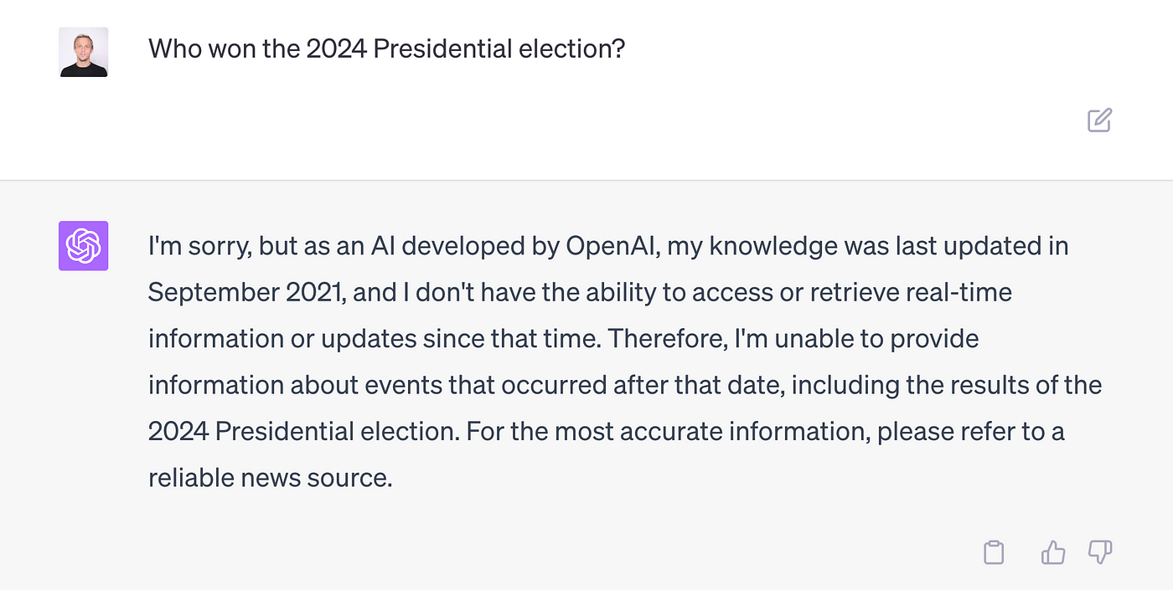
BUT… LLMS CAN ALSO
Present incorrect/false information when it can’t find an answer
Present generic information when the user is asking a specific response
Present outdated information
Present inaccurate information due to wrong context references
Can be biased or non-compliant with laws
and regulations, not follow AI governance processes
Image Source: https://medium.com/google-cloud/generative-ai-understand-and-mitigate-hallucinations-in-llms-8af7de2f17e2

Slide 15

BUT… LLMS CAN ALSO
Present incorrect/false information when it can’t find an answer
Present generic information when the user is asking a specific response
Present outdated information
Present inaccurate information due to wrong context references
Can be biased or non-compliant with laws
and regulations, not follow AI governance processes
Token limitation

Slide 16



LANGCHAIN
Langchain is a framework for developing application powered by Large Language Models
DATA
MODELS
!pip install tiktoken
!pip install pypdf
!pip install langchain
!pip install chromadb
STORAGE

Slide 17


SO, WHAT ARE WE DOING TODAY?
CHAT INTERFACE
QUESTION
EMBEDDING
SEMANTIC SEARCH
Chunk 1
EMBEDDINGS
MODELS
DATA
Chunk 2
EMBEDDINGS
CONTEXT
VECTOR DB
We will be using ChromaDB
Chunk N
EMBEDDINGS

Slide 18

SUMMARY
ADVANTAGES
DISADVANTAGES
Access to vast information for context and knowledge
Generates coherent and human-like responses
Can offer creativity
Performance and speed
Hallucinations
Relies on pre-existing data and could therefore have outdated information
Biased or inaccurate
Resource intensive fine-tuning

Slide 19
REFERENCES
https://aws.amazon.com/what-is/retrieval-augmented-generation/
https://www.youtube.com/watch?v=2xxziIWmaSA&list=PLqZXAkvF1bPNQER9mLmDbntNfSpzdDIU5
https://www.youtube.com/watch?v=LhnCsygAvzY
https://python.langchain.com/docs
https://research.ibm.com/blog/retrieval-augmented-generation-RAG
https://machinelearningmastery.com/what-are-large-language-models/
https://www.ibm.com/blog/open-source-large-language-models-benefits-risks-and-types/

